Slide 1
Fast R-CNN
이재형
Signal Processing & Artificial-intelligence Lab
Hanyang University

Slide 2
Contents
3 drawbacks of R-CNN
How Fast R-CNN solved R-CNN's problems?
RoI pooling
Feature sharing
Hierarchical sampling
Single-stage training
Conclusion
R-CNN의 단점
어떻게 해결했는지
결론

Slide 3
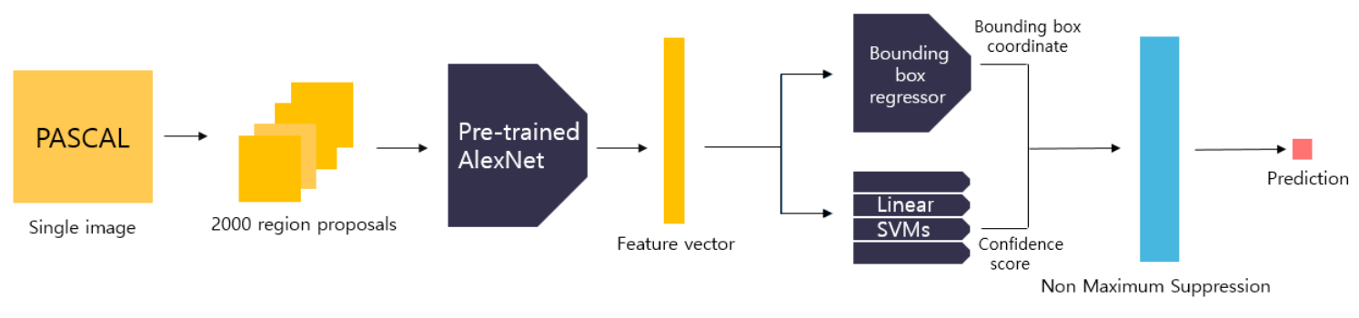
Drawbacks of R-CNN
Very slow inference speed
1 image inference time = 47sec
Expansive training cost in space and time
Need to save AlexNet output feature = hundreds of GB !
Separated training pipeline : complex
AlexNet, Linear SVM, bbox regressor
inference / RoI 각각 forward
2.5GPU / HDD
Most of computations !
R-CNN Architecture

Slide 4
Drawbacks of R-CNN
Very slow inference speed
1 image inference time = 47sec
Expansive training cost in space and time
Need to save AlexNet output feature = hundreds of GB !
Separated training pipeline : complex
AlexNet, Linear SVM, bbox regressor
네트워크 따로 학습
번거롭
성능 end-to-end 밀림
(2) Train
(1) Train
R-CNN Architecture
(3) Train

Slide 5
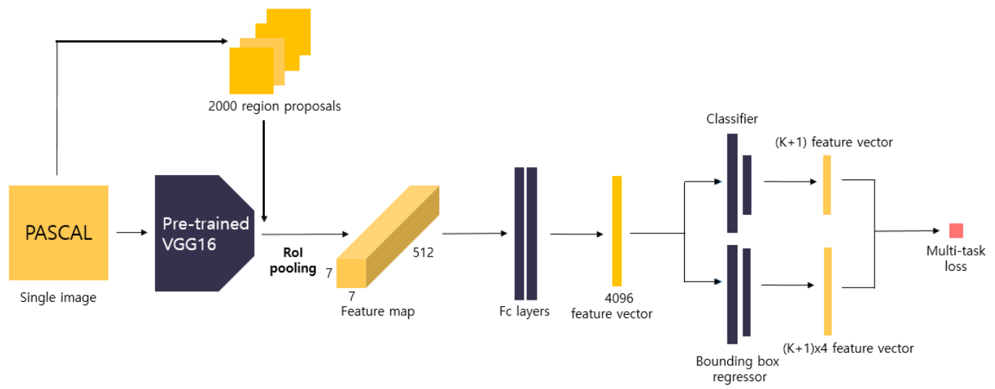
Fast R-CNN – Architecture
Fast R-CNN 어떻게 개선?
모델 세부적 구성
Training pipeline
128 Region proposal
128 RoIs
classifier
feature
vector
multi-task
loss
input image
FC
layers
4096
vector
feature map
bounding
box
regressor
feature
vector
Fast R-CNN Architecture

Slide 6
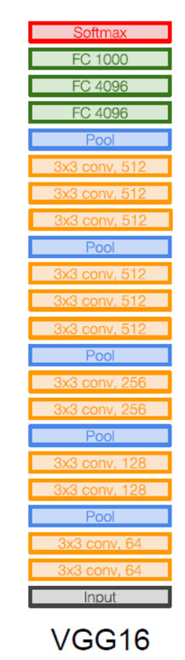
Fast R-CNN – Architecture
Fast R-CNN / VGG-16을 기본 backbone 변형
ImageNet
VGG-16

Slide 7

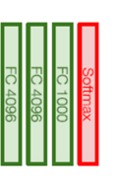
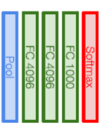



Fast R-CNN – Architecture
Fast R-CNN / transformation
마지막 pooling layer
classifier, bounding box regressor
FC K+1
$$L_{cls}$$
img
RoI pooling layer
$$L_{total}$$
FC (K+1)*4
$$L_{loc}$$
"Fast R-CNN"

Slide 8
Fast R-CNN – Training
모델이 준비되면
Selective Search / region proposal
128 Region proposal
classifier
feature
vector
multi-task
loss
input image
FC
layers
4096
vector
feature map
bounding
box
regressor
feature
vector
Fast R-CNN Architecture

Slide 9
Fast R-CNN – Training
여기서 Fast R-CNN은
이미지를 ConvNet forward / feature map
Region Proposal 을 feature map
이 과정 / R-CNN 단점 / model speed
어떻게 feature map에 RoI 먼저
128 Region proposal
classifier
feature
vector
multi-task
loss
input image
FC
layers
4096
vector
feature map
bounding
box
regressor
feature
vector
Fast R-CNN Architecture

Slide 10
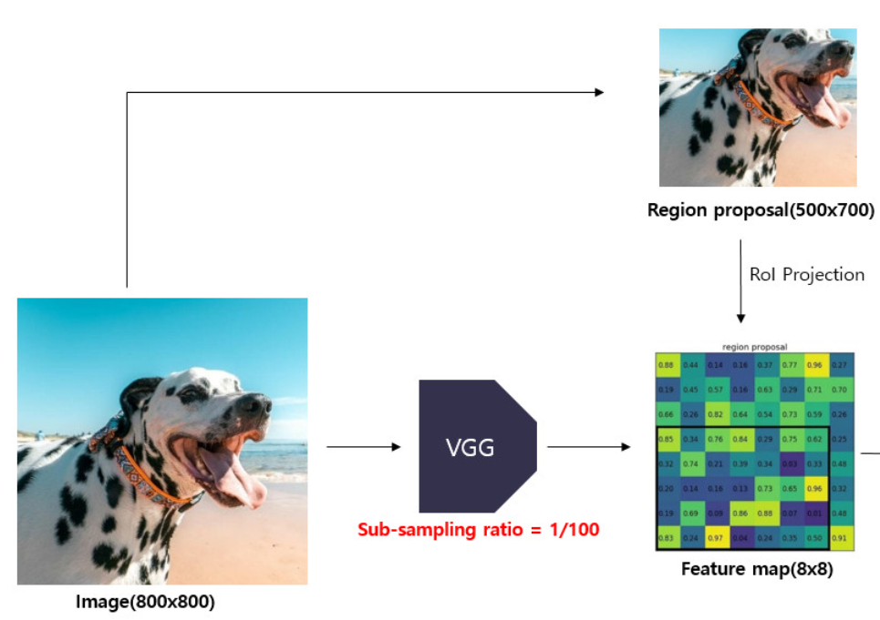
Fast R-CNN – Training
feature map 크기 / 원본이미지 / 비례
원본에서 RoI 해당영역
feature map에 projection 가능
Region of Interest (450x550)
feature map (h x w)
image(600 x 600)
RoI projection

Slide 11
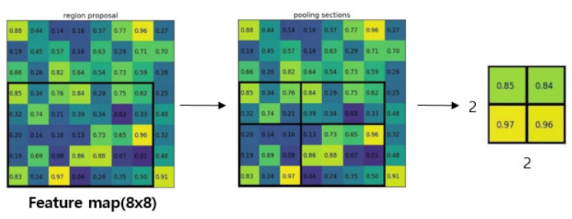
Fast R-CNN – Training
구체적인 projection 과정 설명
미리 정해준 output크기인 (H,W) 가 되도록
feature map의 grid를 나누어
영역별 max pooling 수행
feature map에서 RoI에 대응하는 / 고정크기 vector
이 과정 max pooling
H
W
feature map (h x w)
RoI pooling

Slide 12
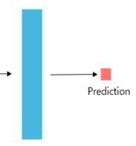
Fast R-CNN – feature sharing
하나의 이미지 처리할 때 한번만 feature map 을 구해 여러 RoI 의 vector 구할 수 있어짐
(기존 단점)
(효율증가)
속도 개선
minibath
training 속도도 개선
느린 training, inference속도를 더욱 개선했다고 생각이 됩니다.
2000 forward for 1 image
R-CNN inference
1 forward for 1 image
classifier
feature
vector
multi-task
loss
input image
FC
layers
4096
vector
feature map
bounding
box
regressor
feature
vector
Fast R-CNN inference

Slide 13
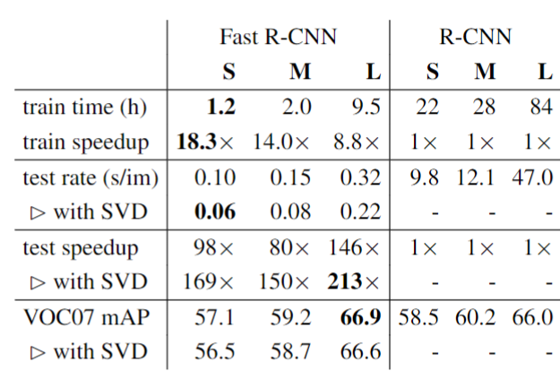
Fast R-CNN – Training
다양한 모델들
속도
much faster
1.
S : AlexNet
M : AlexNet (Wider)
L : VGG-16
1 forward for 1 image
classifier
feature
vector
multi-task
loss
input image
FC
layers
4096
vector
feature map
bounding
box
regressor
feature
vector
Fast R-CNN inference

Slide 14
Fast R-CNN – Training
Classifier와
BBox regressor
multi-class loss
128 RoIs
classifier
feature
vector
multi-task
loss
input image
FC
layers
4096
vector
feature map
bounding
box
regressor
feature
vector
Fast R-CNN Architecture

Slide 15

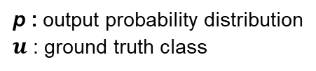
Fast R-CNN – Training
분류 클래스 K개
background 포함 K+1개로 feature을 분류
log softmax
Input 4096 size feature vector
output (K+1) sized vector
$$L_{cls}\left(p,u\right)=−logp_{u}$$
p : output probability distribution
$u$: ground truth class
128 RoIs
classifier
feature
vector
multi-task
loss
input image
FC
layers
4096
vector
feature map
bounding
box
regressor
feature
vector
Fast R-CNN Architecture

Slide 16
Fast R-CNN – Training
동일한 feature vec
해당 region proposa의 클래스별 bounding box 좌표 반환
bbox 4개의 실수
클래스캐수 * 4
Input 4096 size feature vector
output 4*(K+1) sized vector
128 RoIs
classifier
feature
vector
multi-task
loss
input image
FC
layers
4096
vector
feature map
bounding
box
regressor
feature
vector
Fast R-CNN Architecture

Slide 17
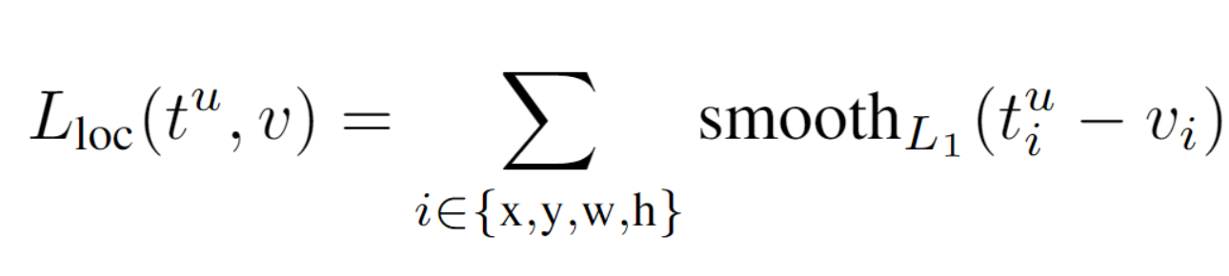
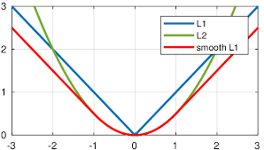
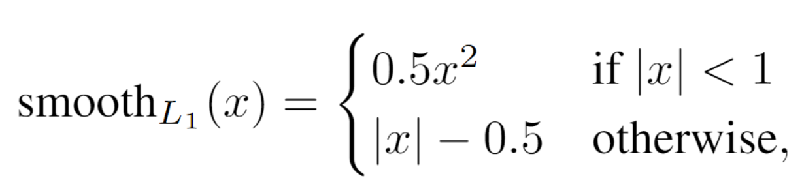



Fast R-CNN – Training
smooth L1 loss
예측과 정답 위치
SVM처럼 많이 비슷하면 감소
아님 멀리
충분히 가까울 때 loss를 더 줄여 학습 시 grad 튀는걸 방지 예상
bounding box regression Loss
pred location
ground truth

Slide 18

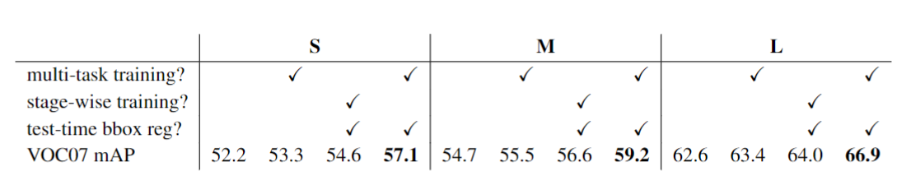
Fast R-CNN – Training
Multi-task loss는
두 loss의 합
꺾쇠는 참이면 1
bbox BG는 GT없으니
Multi-task Loss
for background class(u=0), ignore L_loc
u : ground truth class
S : AlexNet
M : AlexNet (Wider)
L : VGG-16
multi-task learning is good for this model !

Slide 19
Conclusion
RoI별 feature 아닌 image 별 feature -> 병목
multi-task learning: 모델 전체 효과적 학습
파이프라인 간소화
내 task와 데이터, 모델 의 성질 공통점 이용 접근
128 RoIs
classifier
feature
vector
multi-task
loss
input image
FC
layers
4096
vector
feature map
bounding
box
regressor
feature
vector
Fast R-CNN Architecture

Slide 20
Thank You
이재형
Signal Processing & Artificial-intelligence Lab
Hanyang University

